Slide 1
Covid-19 and Press Freedom Index

Slide 2
Goal
I have been inspired to answer the question, are there any countries lying about their epidemic situation?
For answering this question, I am going to analyze the relationship between Press-Freedom Index 2020 and COVID-19 situation information in each country.

Slide 3
Source of data
Epidemic data is scraped from Worldometers on April 6, 2020.
Press-Freedom Index 2020 are published by Reporter Without Boarder.

Slide 4
Press Freedom Index
Press Freedom Index (PFI) is an annual ranking of countries compiled and published by Reporter Without Border since 2002. The rank score is calculated by how violent the state, the Internet environment, censorship policy,... affect the level of media independence and legislative framework for media, or the free flow of information on the Internet. The year of the report is the year the report was released and intends to reflect events in the prior year.
Please take a note, PFI score is calculated by how violent is in particular countries, so a smaller score on the report corresponds to greater freedom of the press.

Slide 5
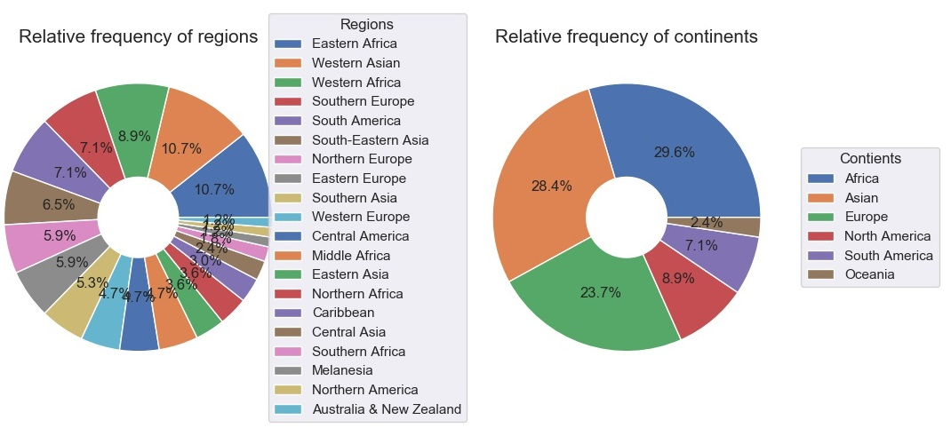
Distribution

Slide 6
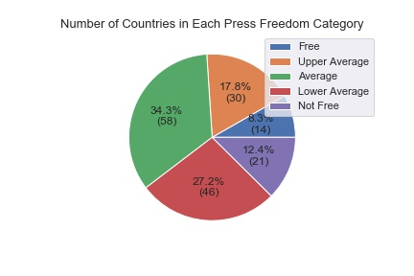
Five Situations

Slide 7
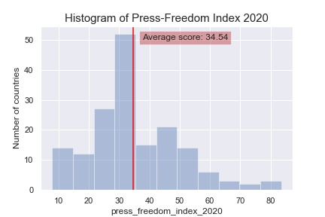
Average PFI Score

Slide 8
PFI and Epidemic Situation

Slide 9
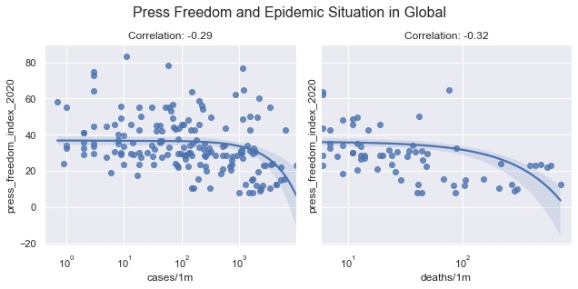
Correlation in Global

Slide 10
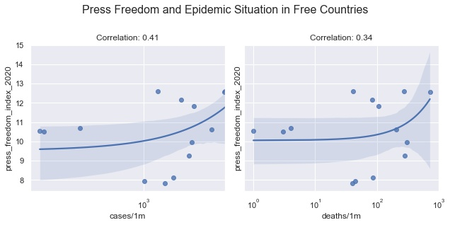
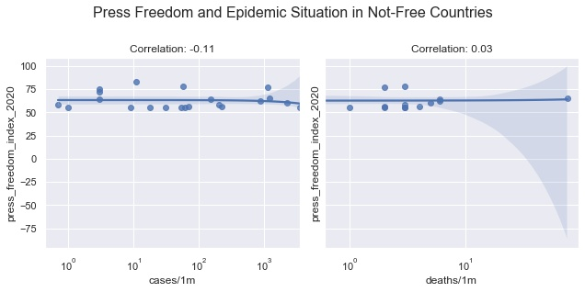
Correlation in Free and Not-Free Situations

Slide 11
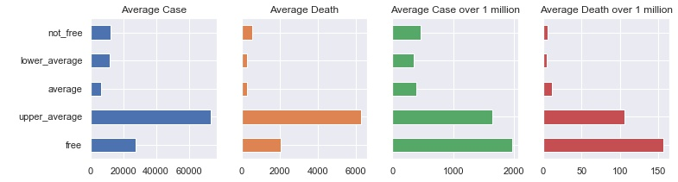
Average Epidemic Index by Press Freedom Category
Notes:
By the average number of cases, deaths, cases/1m, and deaths/1m, there is a huge difference between the free and upper average (also consider almost free) group with others.
Or this shows us the average - lower average - not-free groups are having extremely good anti-epidemic performance.

Slide 12
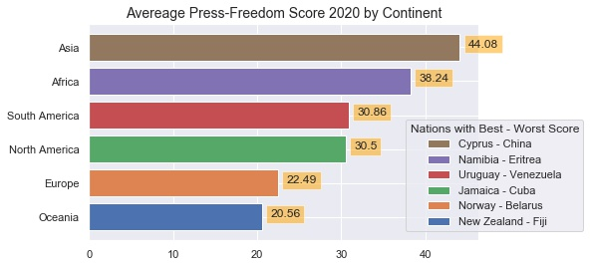
PFI by Continent Raking

Slide 13
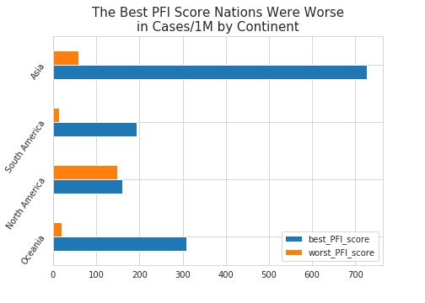
The Best vs The Worst
Notes:
There are four continents that are having their nation with the worst PFI that is doing better in anti-epidemic.
But three from those continents come from bottom four in average PRI continent rank, and the PRI score is higher than 30.

Slide 14
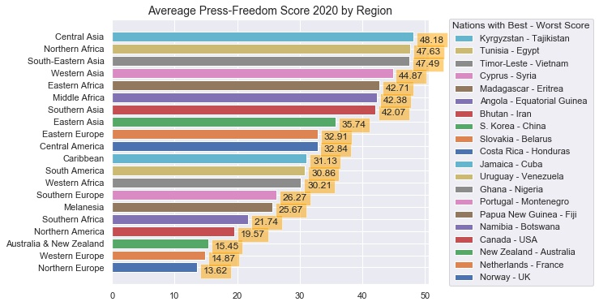
PFI by Region Raking

Slide 15
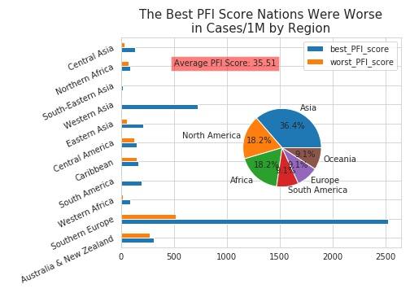
The Best and worst PFI Score each Region by Number of Cases over 1 Million Population
Notes:
There are eleven (among twenty) regions whose the best PFI score nations are higher cases/1m than the worst ones.
But 54.6 percent (36.4% from Asia and 18.2% from Africa) of regions come from the two worst average PFI score continents.

Slide 16
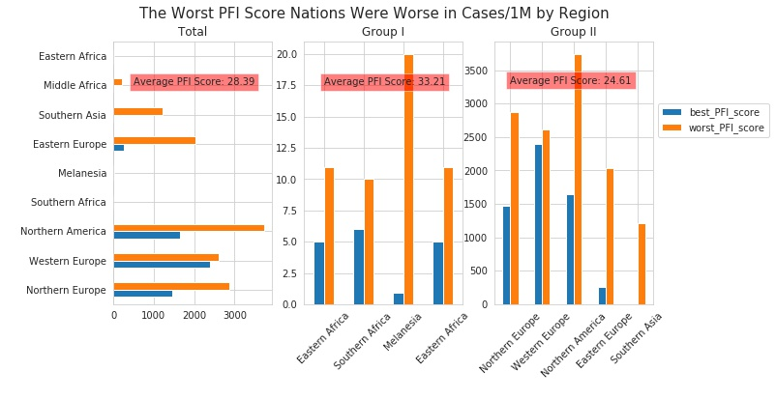
The Best and worst PFI Score each Region by Number of Cases over 1 Million Population
Notes:
Group of the best PFI score countries, whose cases/1m is lower than the worst ones, is 28.39 average PFI score. Comparing to 35.51 of the group above, this group is much freer in media.
In addition to looking carefully at Group I (in the figure) whose performance is extremely better than Group II (in the figure), it is also worse in average PFI score, 24.61 compares to 33.21.

Slide 17
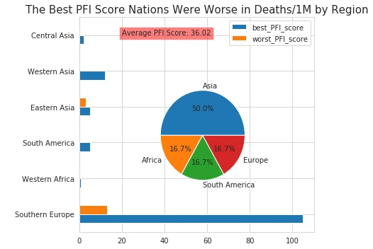
The Best and worst PFI Score each Region by Number of Deaths over 1 Million Population
Notes:
There are six regions whose the best PFI score nations are higher deaths/1m than the worst ones. But once again, the majority (89.7 percent) of the regions come from three bottom rank of average PFI score continent.

Slide 18
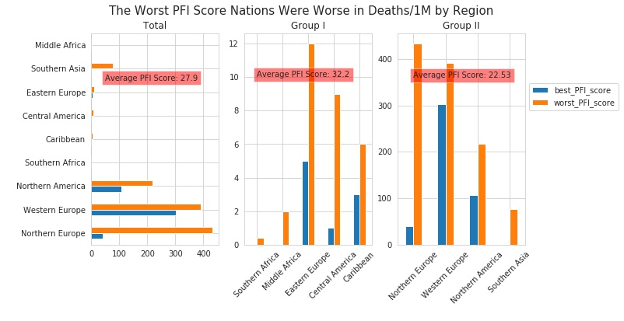
The Best and worst PFI Score each Region by Number of Deaths over 1 Million Population
Notes:
Group of the best PFI score countries, whose deaths/1m is lower than the worst ones, is 27.9 average PFI score. Comparing to 36.02 of the group above, that means this group is also freeer at media.
By [cases/1m](#by_cases/1m) and [death/1m](#by_deaths/1m), it's obviously the worse PFI score the better anti-epidemic performance.

Slide 19
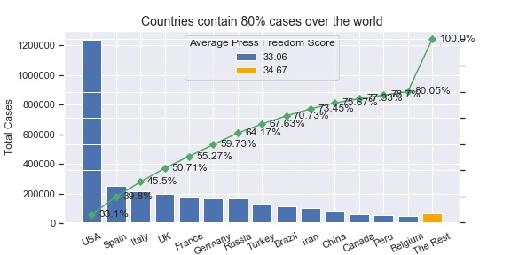
Total Number of Cases
Notes:
* The number of countries that contain 80 percent of cases over the world is 14, but their average PFI score is better than the rest of the world.

Slide 20
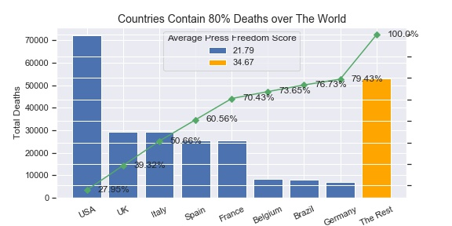
Total Number of Deaths
Notes:
* The same thing happened to the total of deaths, there are only 8 countries take 80 percent of deaths over the world and their average PFI score is really much better than the rest.

Slide 21
Conclusion
There is no direct evidence that can indicate the low FPI nations lying about their COVID-19 situation. But we have a right to question their transparency of publishing information because there is, through this report, a quite strong correlation between having good performance in epidemic and bad Press-Freedom Index.

Slide 22
Limitation and Improvement
The biggest limitation in this report is only one national index to compare with four indicators of epidemic situation. So the best way to improve this report is to collect more data to extract insight, evidence, or causal relationship.

